Slide 1




Python And MySQL Project including Tkinter(GUI)
Made by
Vivek Kumar, Aditiya Raj Himtania
and Aman Kumar

Slide 2

ACKNOWLEDGEMENT
I WOULD LIKE TO EXPRESS MY SPECIAL THANKS OF GRATITUTE TO MY TEACHER
Mrs. NIDHI UPADHYAY WHO GAME ME AND MY BATCHMATES THE GOLDEN OPPORTUNITY TO DO THIS WONDERFUL PROJECT,WHICH ALSO HELPED ME AND MY BATCHMATES IN DOING A LOT OF RESEARCH AND I CAME TO KNOW ABOUT SO MUCH NEW THINGS .I AM REALLY THANKFUL TO YOU.
SECONDLY,I WOULD LIKE TO THANK MY PARENTS AND FRIENDS WHO HELPED ME A LOT IN FINALIZING THIS PROJECT WITHIN THE LIMITED TIMEFRAME.

Slide 3
CERTIFICATE
THIS IS TO CERTIFY THAT VIVEK KUMAR, ADITIYA RAJ HIMTANIA AND AMAN KUMAR STUDENT OF CLASS 12TH A HAS SUCCESSFULLY COMPLETED THE RESEACH ON THIS PROJECT UNDER MY SUPERVISION.THEY HAS TAKEN PROPER CARE AND SHOWN UTMOST SINCERITY IN THE COMPLETION OF THIS PROJECT.I CERTIFY THAT THIS PROJECT IS UPTO MY EXPECTATIONS AND AS PER THE GUIDELINES ISSUED BY CBSE.
TEACHER’S SIGNATURE
EXAMINER’S SIGNATURE

Slide 4
CONTENTS
1. Introduction
2. Objective & Scope of the Project
3. Theoretical Background
4. System Implementation
4.1 The Hardware used:
4.2 The Softwares used:
5. System Design & Development
5.1 Project Code:
5.2 Output:
6. User Manual
7. References

Slide 5
INTRODUCTION
In today’s world, efficient and secure management of banking operations is essential for both financial institutions and customers.
This project, Bank Management System, is developed using Python to streamline basic banking operations, ensuring ease of use, security, and reliability.
The Bank Management System is designed to simulate fundamental banking functionalities such as account creation, balance inquiry, deposits, withdrawals, and account closure. It serves as a practical application of core programming concepts like file handling, data structures, and exception handling, while also showcasing how technology can be leveraged to optimize real-world processes.
Objective & Scope of the Project
The objective of the software project is to develop the functions of Bank. This software project is also aimed to enhance the current record keeping system, which will help managers to retrieve the up-to-date information at right time in right shape.
The proposed software system is expected to do the following functionality-
To provide a user friendly.
The proposed system should maintain all the records and transactions, and should generate the required reports and information when required.

Slide 6
To provide graphical and user-friendly interface to interact with a centralized database based on client-server architecture.
To identify the critical operation procedure and possibilities of simplification using modern IT tools and practices.
In its current scope, the software enables Officer to retrieve and update the information from centralized database designed with MySQL . This software does not require much training time of the users due to limited functionality and simplicity.
Despite of the best effort of the developer, the following limitations and functional boundaries are visible, which limits the scope of this application software.
This software can store records and produce reports in pre-designed format in soft copy. There is no facility yet to produce customized reports. Only specified reports are covered.
There is no provision to calculate fine or penalty etc. for defaulter members; however it can be developed easily with the help of adding modules.
Some application areas like Updation along with late return fine, Fees defaulters etc. are not implemented in the project. This project is made by keeping in mind that it is to be used only by Officers, which can facilitate ease control.

Slide 7
THEORETICAL BACKGROUND
What is Database?
Introduction and Concepts:
A database is a collection of information related to a particular subject or purpose, such as tracking customer orders or maintaining a product collection. Using any RDBMS application software like MS SQL Server, MySQL, Oracle, Sybase etc, you can manage all your information from a single database file. Within the file, divide your data into separate storage containers called tables. You may and retrieve the data using queries.
A table is a collection of data about a specific topic, such as products or suppliers. Using a separate table for each topic means you can store that data only once, which makes your database more efficient and reduces data-entry errors. Table organises data into columns (called fields) and rows (called records).
A Primary key is one or more fields whose value or values uniquely identify each record in a table. In a relationship, a primary key is used to refer to specific record in one table from another table. A primary key is called foreign key when it is referred to from another table.
To find and retrieve just the data that meets conditions you specify, including data from multiple tables, create a query. A query can also update or delete multiple records at the same time, and perform built-in or custom calculations on your data.

Slide 8

What isMySQL ?
The management of data in a database system is done by means of a general-purpose software package called a Database Management System (DBMS). Some commercially available RDBMS are MS SQL Server, MS ACCESS, INGRES, ORACLE, and Sybase.
MySQL, the most popular Open Source SQL database management system, is developed, distributed, and supported by Oracle Corporation. MySQL is named after co-founder Monty Widenius's daughter, My. The name of the MySQL Dolphin (our logo) is “Sakila,”.
The Main Features of MySQL
Written in C and C++.
Works on many different platforms.
Uses multi-layered server design with independent modules.
Provides transactional and nontransactional storage engines.
Designed to make it relatively easy to add other storage engines. This is useful if you want to provide an SQL interface for an in-house database.
Uses a very fast thread-based memory allocation system.
Executes very fast joins using an optimized nested-loop join.
Implements SQL functions using a highly optimized class library that should be as fast as possible. Usually there is no memory allocation at all after query initialization.

Slide 9
MySQL client programs can be written in many languages. A client library written in C is available for clients written in C or C++, or for any language that provides C bindings.
APIs for C, C++, Eiffel, Java, Perl, PHP, Python, Ruby, and Tcl are available, enabling MySQL clients to be written in many languages.
The Connector/ODBC (MyODBC) interface provides MySQL support for client programs that use ODBC (Open Database Connectivity) connections.
The Connector/J interface provides MySQL support for Java client programs that use JDBC connections. Clients can be run on Windows or Unix. Connector/J source is available.

Slide 10
SYSTEM IMPLEMENTATIONS
The Hardware used:
While developing the system, the used hardware are:
PC with Intel Core i3 processor having 4.00 GB RAM, SVGA and other required devices.
The Softwares used:
Microsoft Windows® 10 as Operating System.
Python 3.12 as Front-end Development environment.
MySQL as Back-end Sever with Database for Testing.
MS-Word 2010 for documentation.

Slide 11
SYSTEM DESIGN & DEVELOPMENT
This project serves as a convenient tool for both bank employees and customers to manage and track account details effectively. It offers the following features:
- **Account Creation**
- **Transactions**: Deposit and withdrawal options.
- **Reports**: Includes account lists, mini-statements, and more. ### Requirements:
- **MySQL**: Ensure MySQL is installed and configured.
- **Python Libraries**:
- For GUI: tkinter (including `ttk` and `messagebox` modules).
- For Database: `mysql.connector` and `datetime`.
- For Database: Create bank database in Mysql
- For Database: First create these tables in MySQL
- CREATE TABLE accountmaster ( Account_Number INTEGER PRIMARY KEY, name CHAR(40), Account_Type CHAR(40), DateOfOpening DATE, Address_1 CHAR(100), Address_2 CHAR(100), City CHAR(20), Opening_Balance INTEGER);
CREATE TABLE Transaction ( Account_Number INTEGER, y
Date DATE, Transaction_Type CHAR(1), Amount INTEGER);

Slide 12
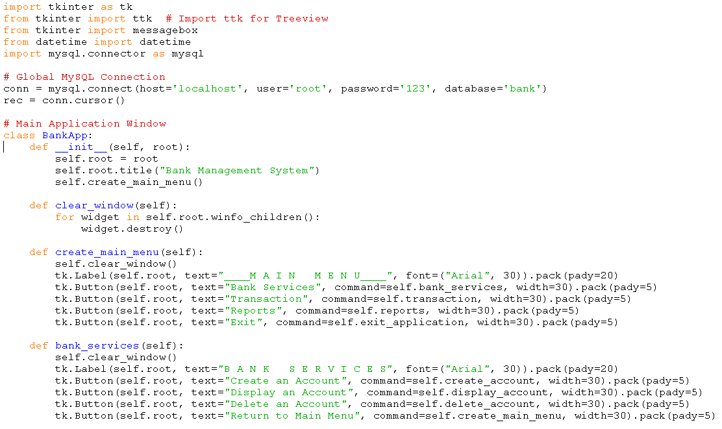
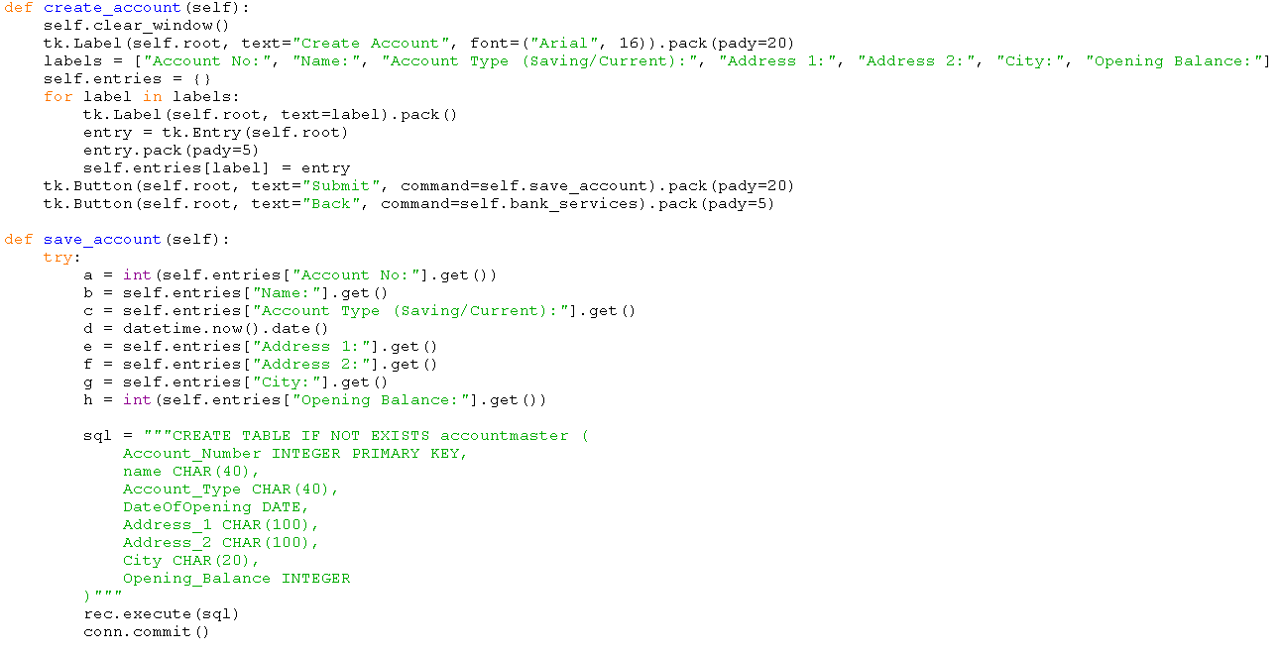
PROJECT CODE

Slide 13
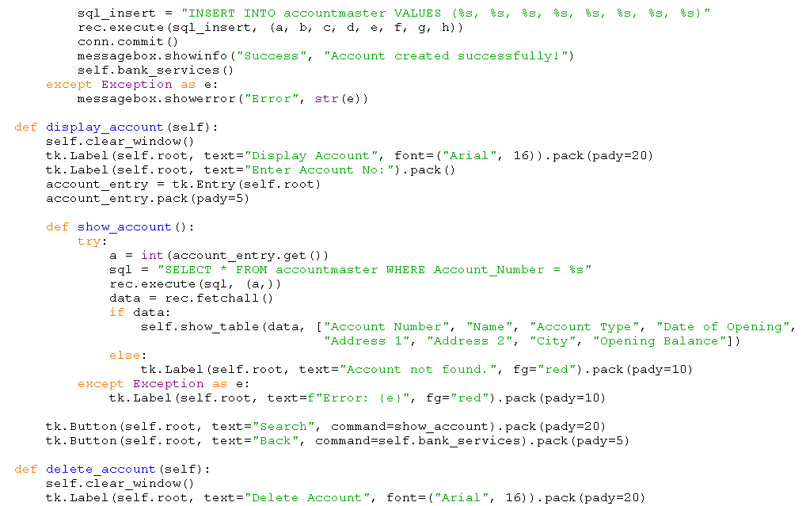
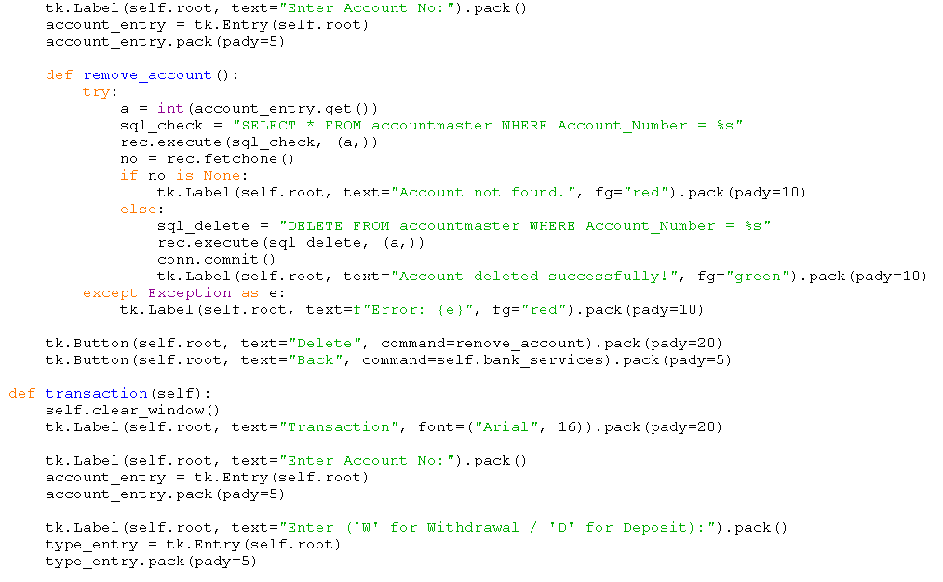

Slide 14
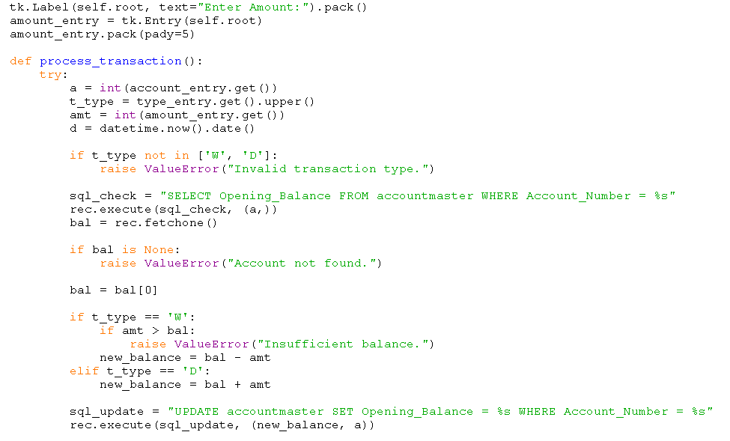
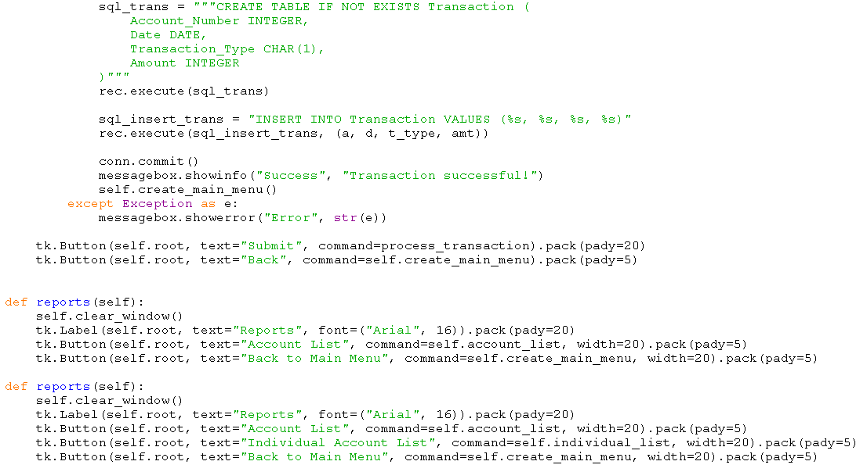

Slide 15
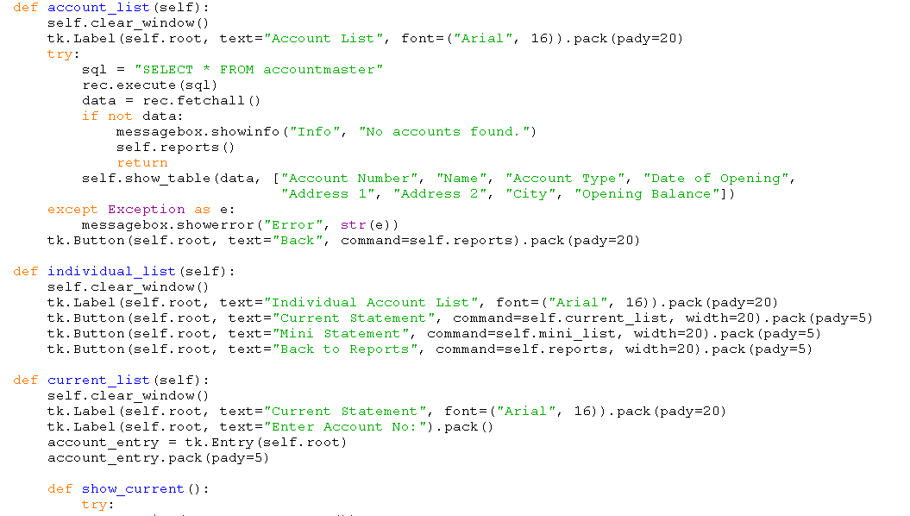
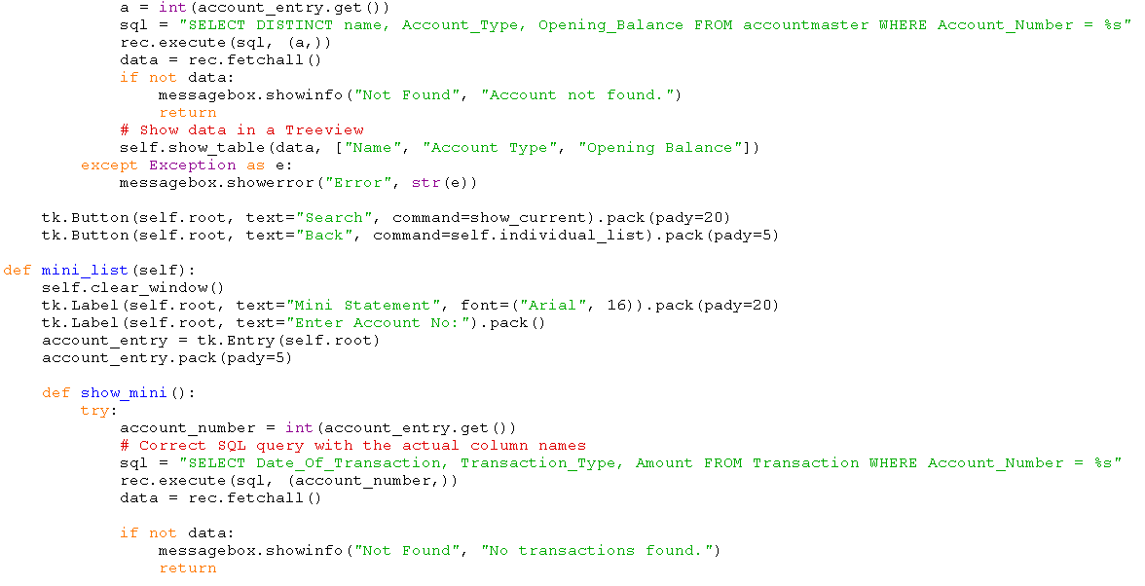
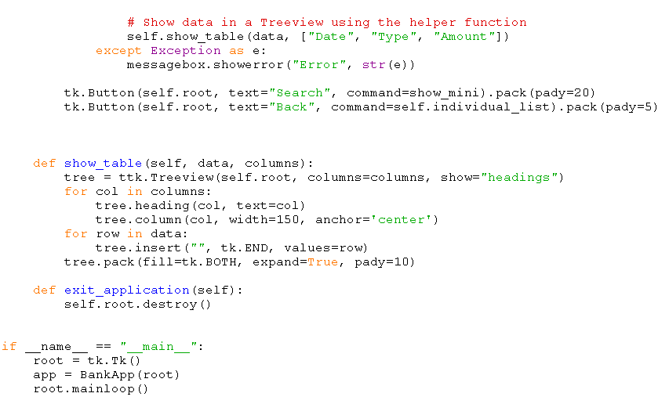

Slide 16
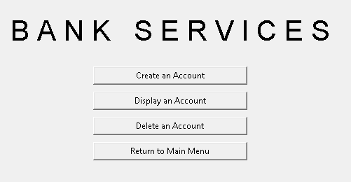
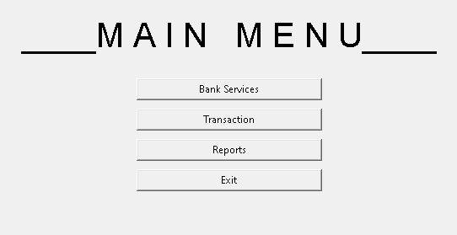
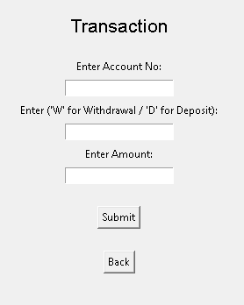
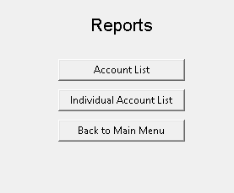
OUTPUT

Slide 17
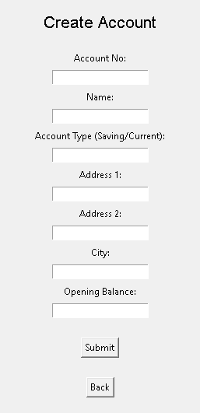
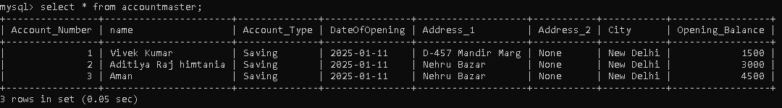
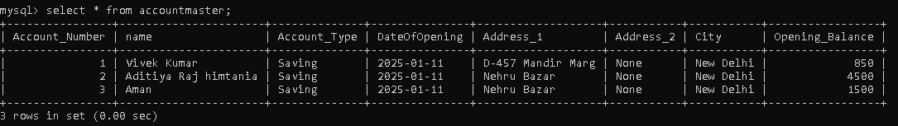
Data Before Updating:-
Data After Updating:-

Slide 18
USER MANUAL
How to install Software:
Hardware Requirement-
Intel Pentium/Celeron or similar processor based PC at Client/Server end.
128 MB RAM and 4GB HDD space (for Database) is desirable.
Standard I/O devices like Keyboard and Mouse etc.
Printer is needed for hard-copy reports.
Local Area Network(LAN) is required for Client-Server Installation
Software Requirement-
Windows XP/2007 OS is desirable.
Python must be installed and mysql connector must be installed.
MySQL Ver 6.1 with Library Database must be present at machine.

Slide 19
REFERENCE
In order to work on this project titled –Bank Management System, the following books and literature are refered by me and my classmates during the various phases of development of the project.
http://www.mysql.org/
Course Book for class XII
Computer Science with Python by Sumita Arora
4. Various Websites of Discussion Forum and software development activities.
Other than the above-mentioned books, the suggestions and supervision of my teacher and my class experience also helped me to develop this software project.

